Slide 1
Packet Sniffing and Spoofing

Slide 2
How Packets Are Received
NIC (Network Interface Card) is a physical or logical link between a machine and a network
Each NIC has a MAC address
Every NIC on the network will hear all the frames on the wire
NIC checks the destination address for every packet, if the address matches the cards MAC address, it is further copied into a buffer in the kernel
Notes:
After copying into the kernel buffer, the card interrupts the CPU informing it about the availability of a new packet

Slide 3
Promiscuous Mode
The frames that are not destined to a given NIC are discarded
When operating in promiscuous mode, NIC passes every frame received from the network to the kernel
If a sniffer program is registered with the kernel, it will be able to see all the packets
In Wi-Fi, it is called Monitor Mode
Notes:
It should be noted that elevated or root privileges are required to put a NIC card in promiscuous mode

Slide 4
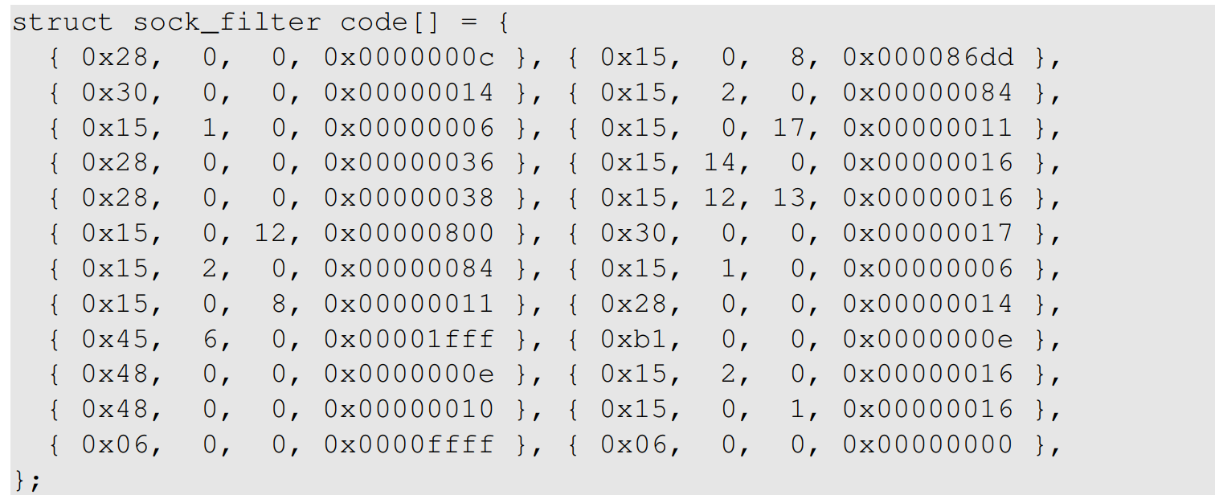
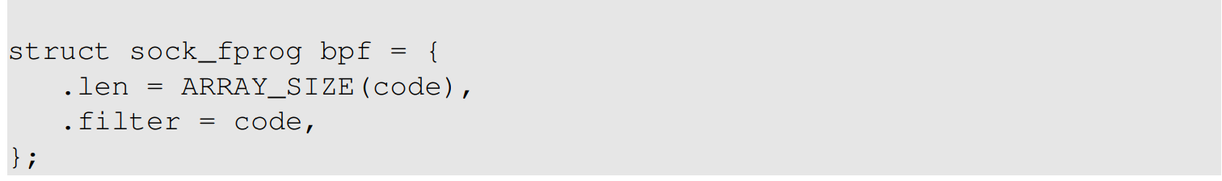
BSD Packet Filter (BPF)
BPF allows a user-program to attach a filter to the socket, which tells the kernel to discard unwanted packets.
An example of the compiled BPF code is shown here.
Notes:
It is very inefficient to discard packets at the application level, so we try to filter packets as early as possible and hence use BPF
The filter is often written in human readable format using Boolean operators and is compiled into a pseudo-code and passed to the BPF driver
This low level code is then interpreted by the BPD pseudo-machine

Slide 5
BSD Packet Filter (BPF)
setsockopt(sock, SOL_SOCKET, SO_ATTACH_FILTER, &bpf, sizeof(bpf))
A compiled BPF pseudo-code can be attached to a socket through setsockopt()
When a packet is received by kernel, BPF will be invoked
An accepted packet is pushed up the protocol stack. See the diagram on the following slide.

Slide 6
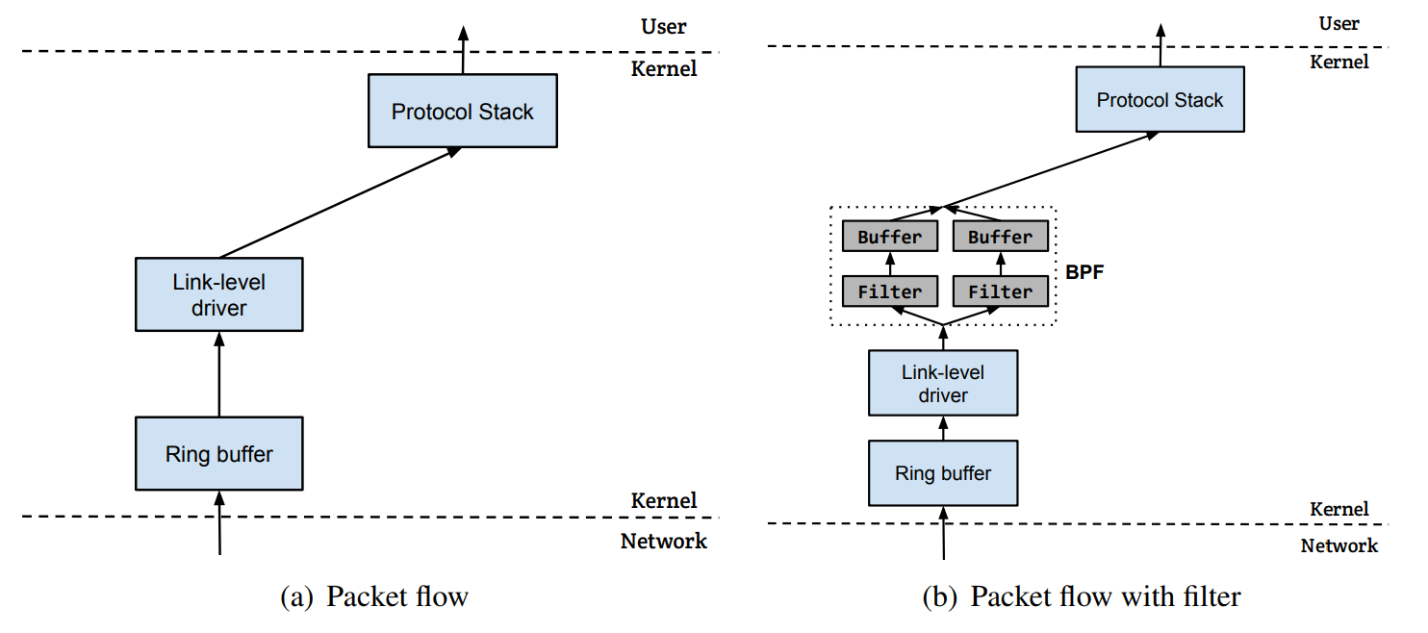
Packet Flow With/Without Filters

Slide 7
Packet Sniffing
Packet sniffing describes the process of capturing live data as they flow across a network
Let’s first see how computers receive packets.

Slide 8
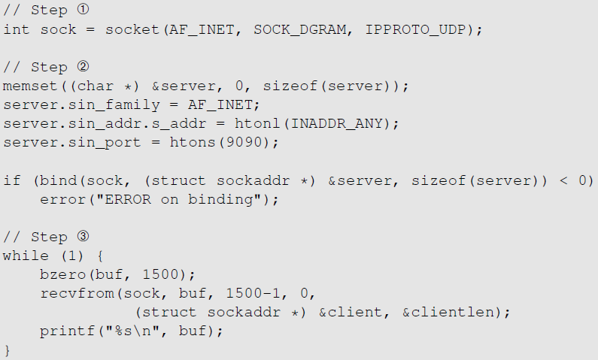
Receiving Packets Using Socket
Create the socket
Provide information about server
Receive packets
Notes:
We first create a socket and provide information about the server, including the UDP port and the IP address
- The bind() system call configures the socket
- By specifying INADDR_ANY, we bind the socket to all available IP addresses
- We use recvfrom() to receive UDP packets

Slide 9
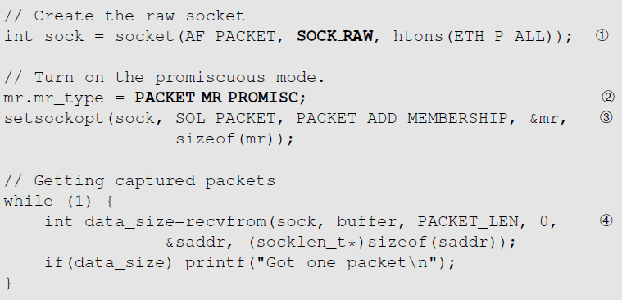
Receiving Packets Using Raw Socket
Creating a raw socket
Capture all types of packets
Enable the promiscuous mode
Wait for packets
Notes:
The code using sockets can only receive packets that are intended for it
A sniffer program needs to capture all packets flowing on the network cable (regardless of destination ip and port number) , this can be done use raw socket
This program shows how to build a simple sniffer program using raw socket

Slide 10
Limitation of the Approach
This program is not portable across different operating systems.
Setting filters is not easy.
The program does not explore any optimization to improve performance.
The PCAP library was thus created.
It still uses raw sockets internally, but its API is standard across all platforms. OS specifics are hidden by PCAP’s implementation.
Allows programmers to specify filtering rules using human readable Boolean expressions.

Slide 11
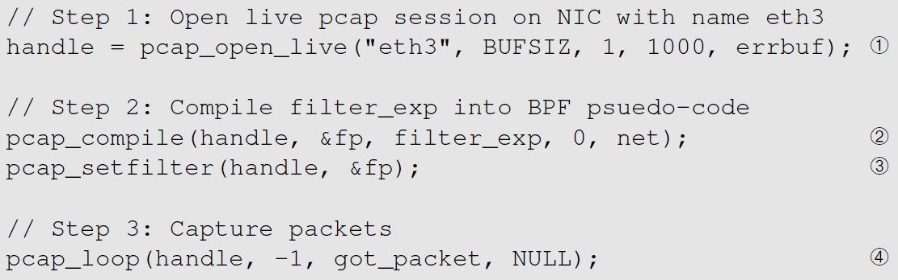
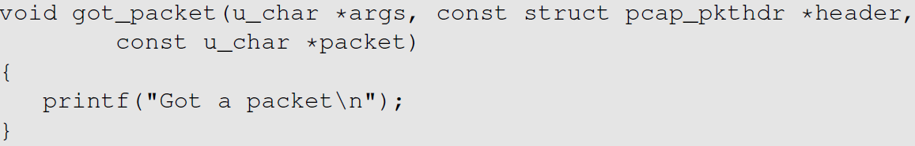
Packet Sniffing Using the pcap API
Initialize a raw socket, set the network device into promiscuous mode.
Filter
Invoke this function for every captured packet
Notes:
Compilation: We can compile the code using the following command:
$ gcc –o sniff sniff.c -lpcap

Slide 12
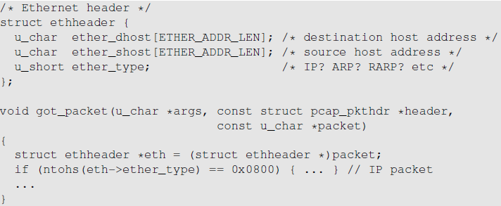
Processing Captured Packet: Ethernet Header
The packet argument contains a copy of the packet, including the Ethernet header. We typecast it to the Ethernet header structure.
Now we can access the field of the structure
Notes:
When got_packet() is invoked, the third argument, a pointer, points to the buffer that holds the packet
The pointer has a unsigned char type, so the contents of the buffer are treated as a sequence of characters
This buffer is actually an Ethernet frame
Since we are only interested in the IP packet, we would like to check whether the type field of the ethernet header is IP
One way is to find the offset of the type field from the beginning of the buffer
This is quite inconvenient. Hence we us the concepts of struct and type casting
A struct is a group of variables that are stored in contigious memory locations
Since we know that the packet buffer sent to got_packet() contains an ethernet frame, we also have the ethernet header structure. We can do a type casting.

Slide 13
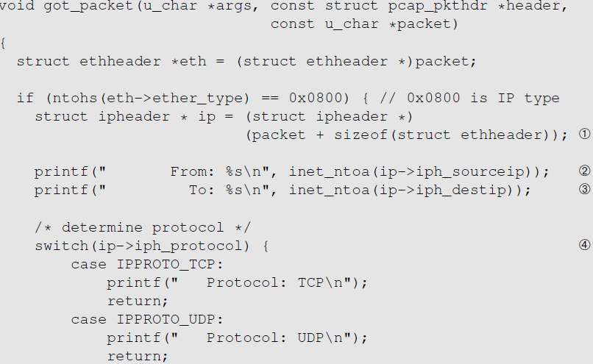
Processing Captured Packet: IP Header
Find where the IP header starts, and typecast it to the IP Header structure.
Now we can easily access the fields in the IP header.

Slide 14
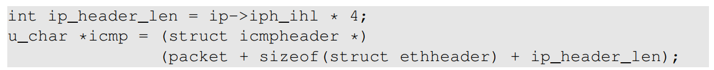
Further Processing Captured Packet
If we want to further process the packet, such as printing out the header of the TCP, UDP and ICMP, we can use the similar technique.
We move the pointer to the beginning of the next header and type-cast
We need to use the header length field in the IP header to calculate the actual size of the IP header
In the following example, if we know the next header is ICMP, we can get a pointer to the ICMP part by doing the following:
Notes:
We should note that the size of the IP header is not fixed because some packets header may contain an extra IP options field

Slide 15
Packet Spoofing
When some critical information in the packet is forged, we refer to it as packet spoofing.
Many network attacks rely on packet spoofing.
Let’s see how to send packets without spoofing.

Slide 16
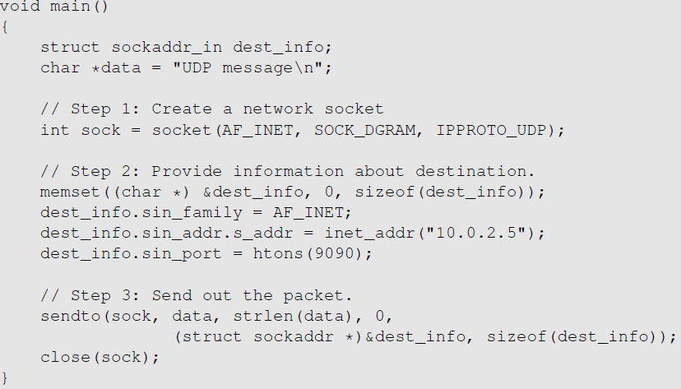
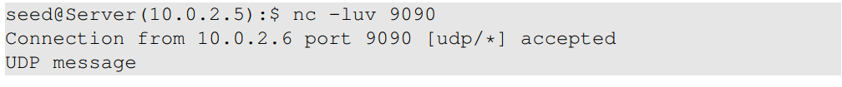
Sending Packets Without Spoofing
Testing: Use the netcat (nc) command to run a UDP server on 10.0.2.5. We then run the program on the left from another machine. We can see that the message has been delivered to the server machine:
Notes:
The first step creates a socket
The second step provides the destination information
In the final step, sendto() is used to send out the UDP packet with the provided payload

Slide 17
Spoofing Packets Using Raw Sockets
There are two major steps in packet spoofing:
Constructing the packet
Sending the packet out

Slide 18
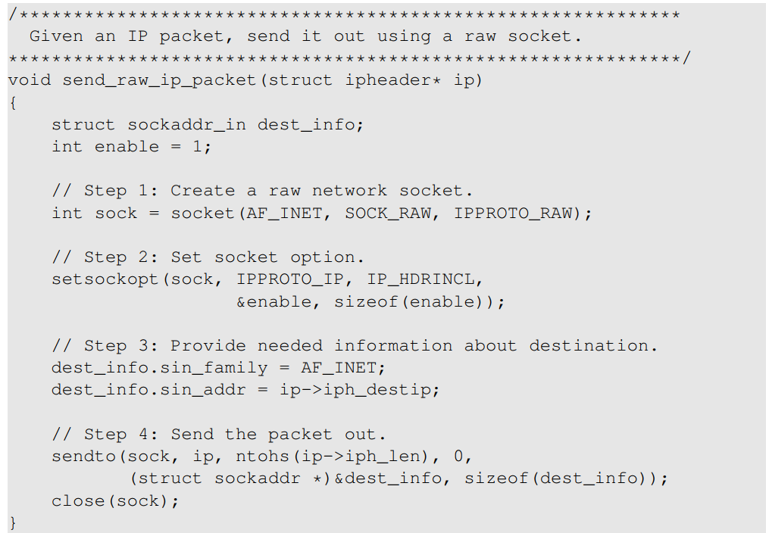
Spoofing Packets Using Raw Sockets
We use setsockopt() to enable IP_HDRINCL on the socket.
For raw socket programming, since the destination information is already included in the provided IP header, we do not need to fill all the fields
Since the socket type is raw socket, the system will send out the IP packet as is.
Notes:
Using the typic socket to send packets, we do not have much control over the header fields
We can only fill in a few header fields, such as the destination IP address and destination port number
The other fields are set by operating system
We use raw sockets to take control of being able to create the whole packet and asking the operating system to “leave us alone”
Step 1:
AF_INET indicates that this is for IPv4
For Second argument we typically use SOCK_DGRAM (for UDP) or SOCK_STREAN ( for TCP ). For raw socket, we use SOCK_RAW
Third argument we choose IPPROTO_RAW indicating that we will supply the IP header
Step 2: It should be noted that by setting the destination IP address, we help the kernel get the correct MAC address corresponding to the destination if the destination is on the same network
Step 4:
the second argument is a pointer to the buffer containing the whole ip packet
Third argument is the size of the packet
Fourth argument is to set flags
The next two arguments are the pointers to the destination sockadd_in structure and its size
For security reasons, only root processes and processes with the CAP_NET_RAW capabilities can create raw sockets

Slide 19
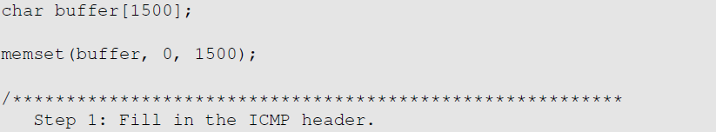
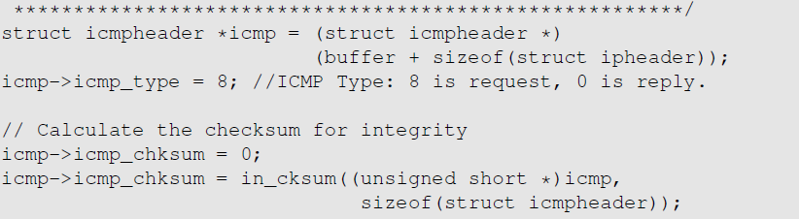
Spoofing Packets: Constructing the Packet
Fill in the ICMP Header
Find the starting point of the ICMP header, and typecast it to the ICMP structure
Fill in the ICMP header fields

Slide 20
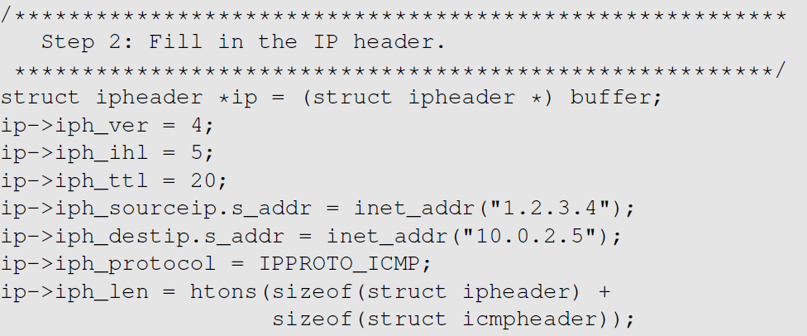
Spoofing Packets: Constructing the Packet
Fill in the IP Header
Typecast the buffer to the IP structure
Fill in the IP header fields
Finally, send out the packet
Notes:
Step 1: it should be noted that we are using the type casting technique. The ICMP echo-request header is very simple, we just have to fill in the type and checksum fields. The payload field is optional, we choose not to use that here.
Step2: we set source and destination IP address to the values of our choice. We do not need to fill in the checksum field as that is calculated by the OS by itself

Slide 21
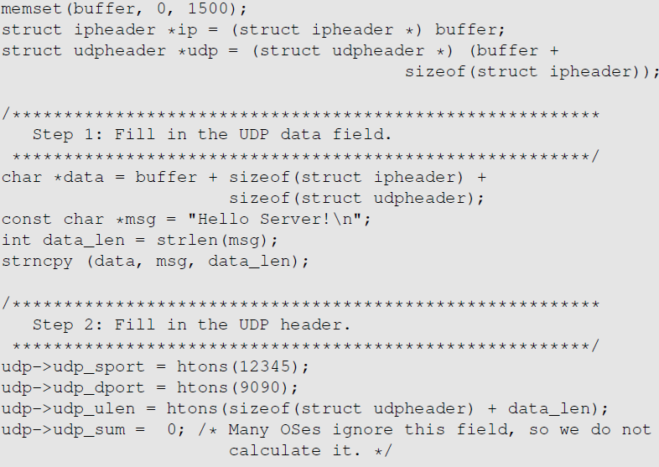

Spoofing UDP Packets
Constructing UDP packets is similar, except that we need to include the payload data now.

Slide 22
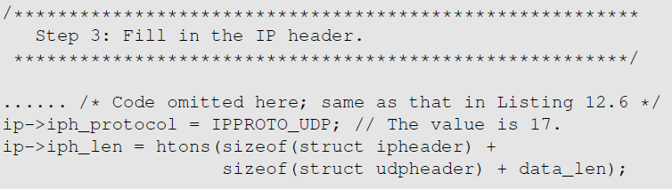
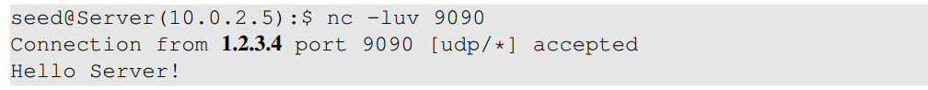
Spoofing UDP Packets (continued)
Testing: Use the nc command to run a UDP server on 10.0.2.5. We then spoof a UDP packet from another machine. We can see that the spoofed UDP packet was received by the server machine.

Slide 23
Sniffing and Then Spoofing
In many situations, we need to capture packets first, and then spoof a response based on the captured packets.
Procedure (using UDP as example)
Use PCAP API to capture the packets of interests
Make a copy from the captured packet
Replace the UDP data field with a new message and swap the source and destination fields
Send out the spoofed reply

Slide 24
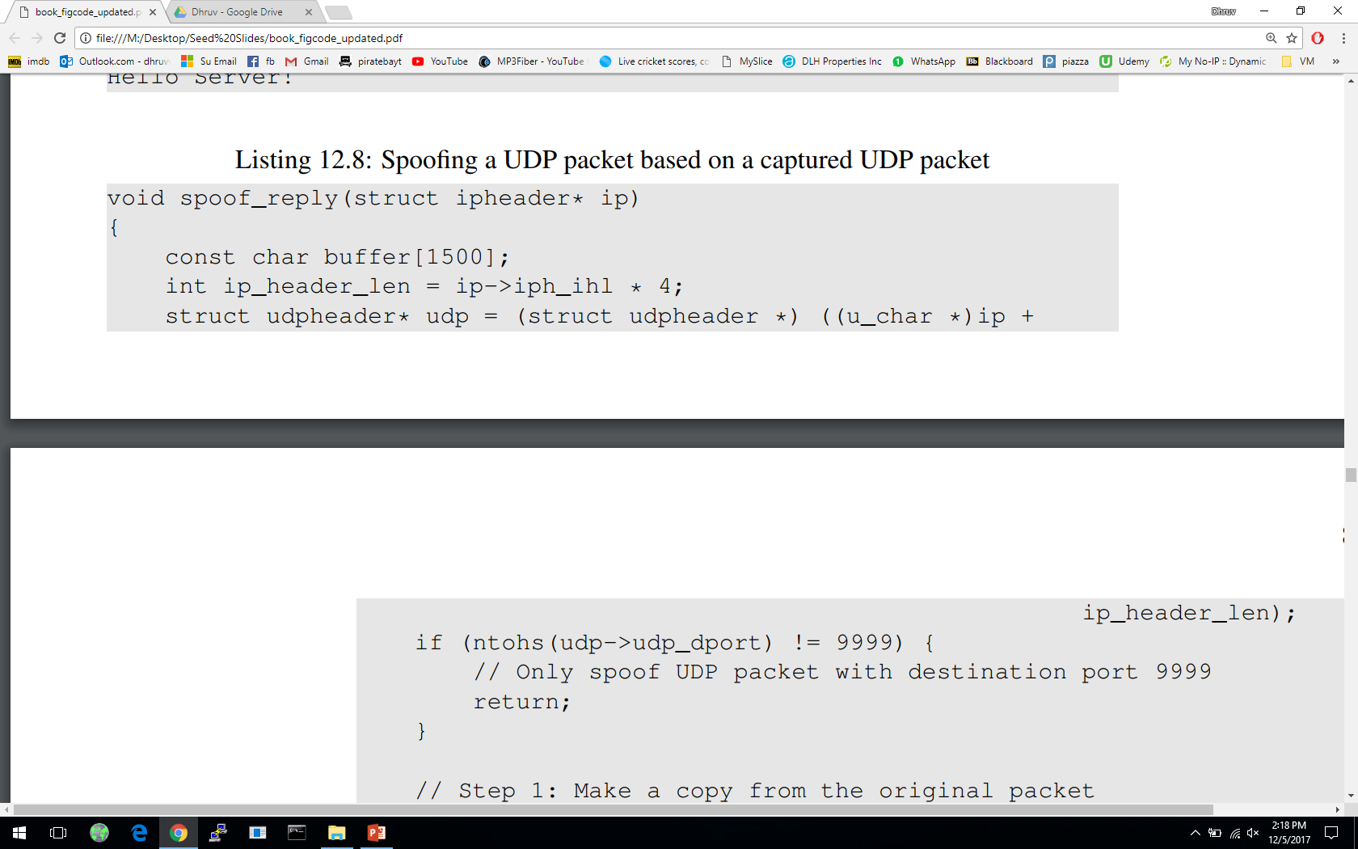
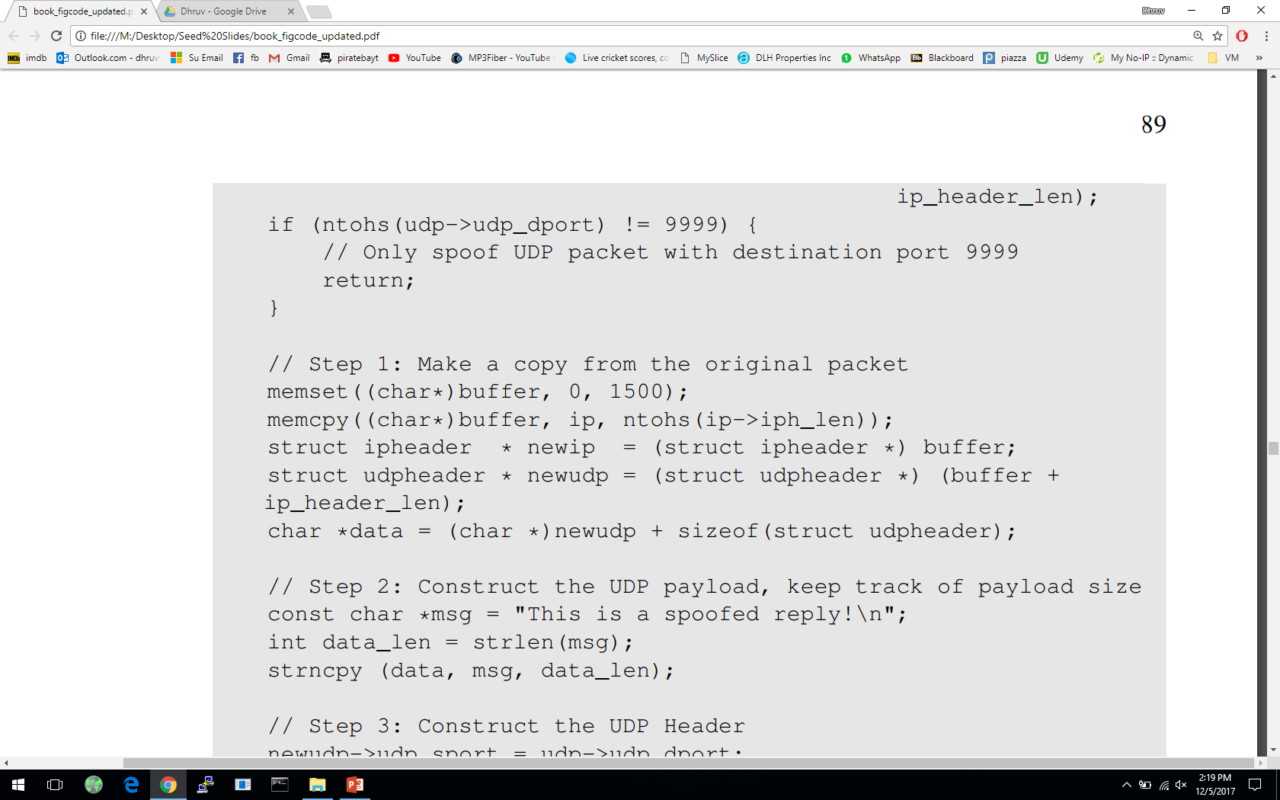
UDP Packet

Slide 25
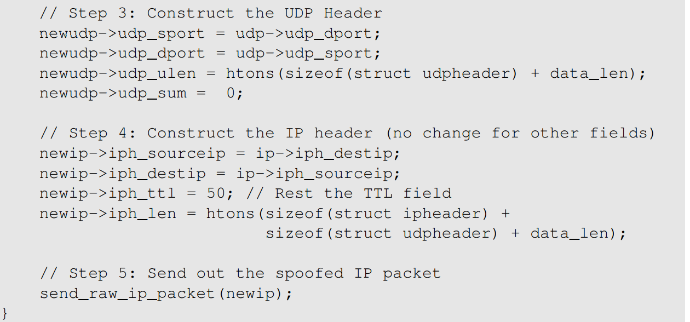
UDP Packet (Continued)

Slide 26
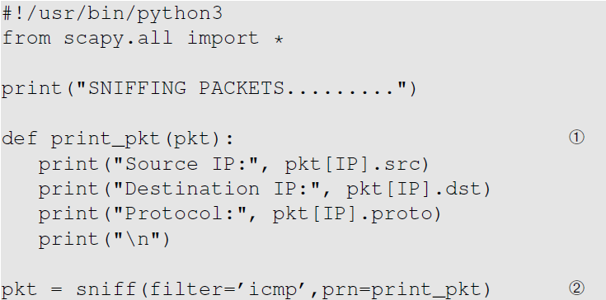
Packing Sniffing Using Scapy

Slide 27
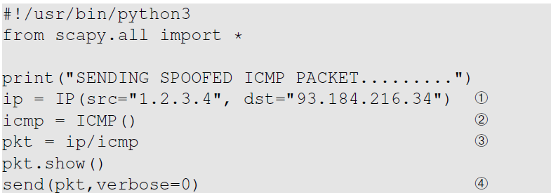
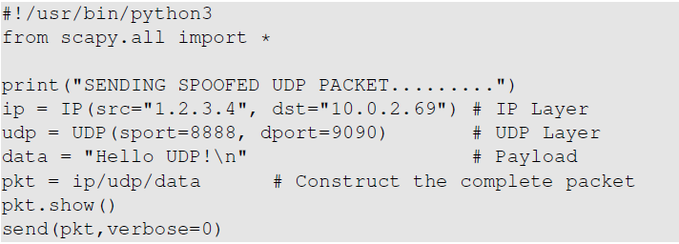
Spoofing ICMP & UDP Using Scapy

Slide 28
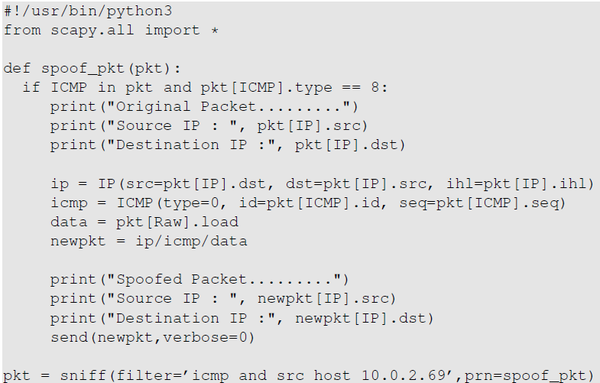
Sniffing and Then Spoofing Using Scapy

Slide 29
Packet Spoofing: Scapy v.s C
Python + Scapy
Pros: constructing packets is very simple
Cons: much slower than C code
C Program (using raw socket)
Pros: much faster
Cons: constructing packets is complicated
Hybrid Approach
Using Scapy to construct packets
Using C to slightly modify packets and then send packets

Slide 30
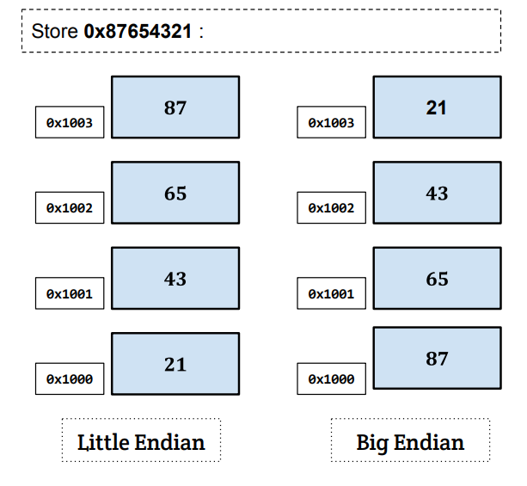
Endianness
Endianness: a term that refers to the order in which a given multi-byte data item is stored in memory.
Little Endian: store the most significant byte of data at the highest address
Big Endian: store the most significant byte of data at the lowest address
Notes:
Htons() and ntohs() convert data to appropriate format.
Smallest addressable unit of memory – byte.
Some datatypes consist of multiple byte in contagious memory eg int = 4 bytes. Short int = 2 bytes.
Question: how are multiple bytes arranged in the memory: least significant bytes are put in the lower address or higher address?
Different computer architectures does it differently. Eg: Atmel AVR32, IBM z/Architecture mainframes use Big-Endian byte order; x86 uses Little-Endian byte order

Slide 31
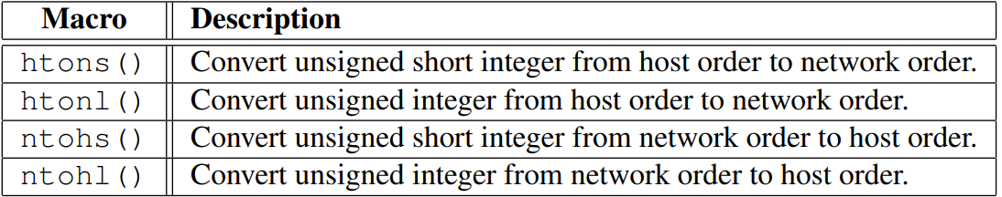
Endianness In Network Communication
Computers with different byte orders will “misunderstand” each other.
Solution: agree upon a common order for communication
This is called “network order”, which is the same as big endian order
All computers need to convert data between “host order” and “network order” .
Notes:
To solve the endianness-mismatching problem when data is send over the network, IANA defined a common order called network byte order, regardless of what endianness the host has.
The conversion function figures out the endianness of the host, and conduct the conversion accordingly.
Conversion macros have easy names:
Htons means host to network byte order conversion
Ntohl meand network to host byte order conversion
s -> short integer
l ->long integer

Slide 32
Summary
Packet sniffing
Using raw socket
Using PCAP APIs
Packet spoofing using raw socket
Sniffing and the spoofing
Endianness

